Slide 1

What is the signature of a trion in ARPES?
Jinyuan Wu, Diana Qiu

Slide 2
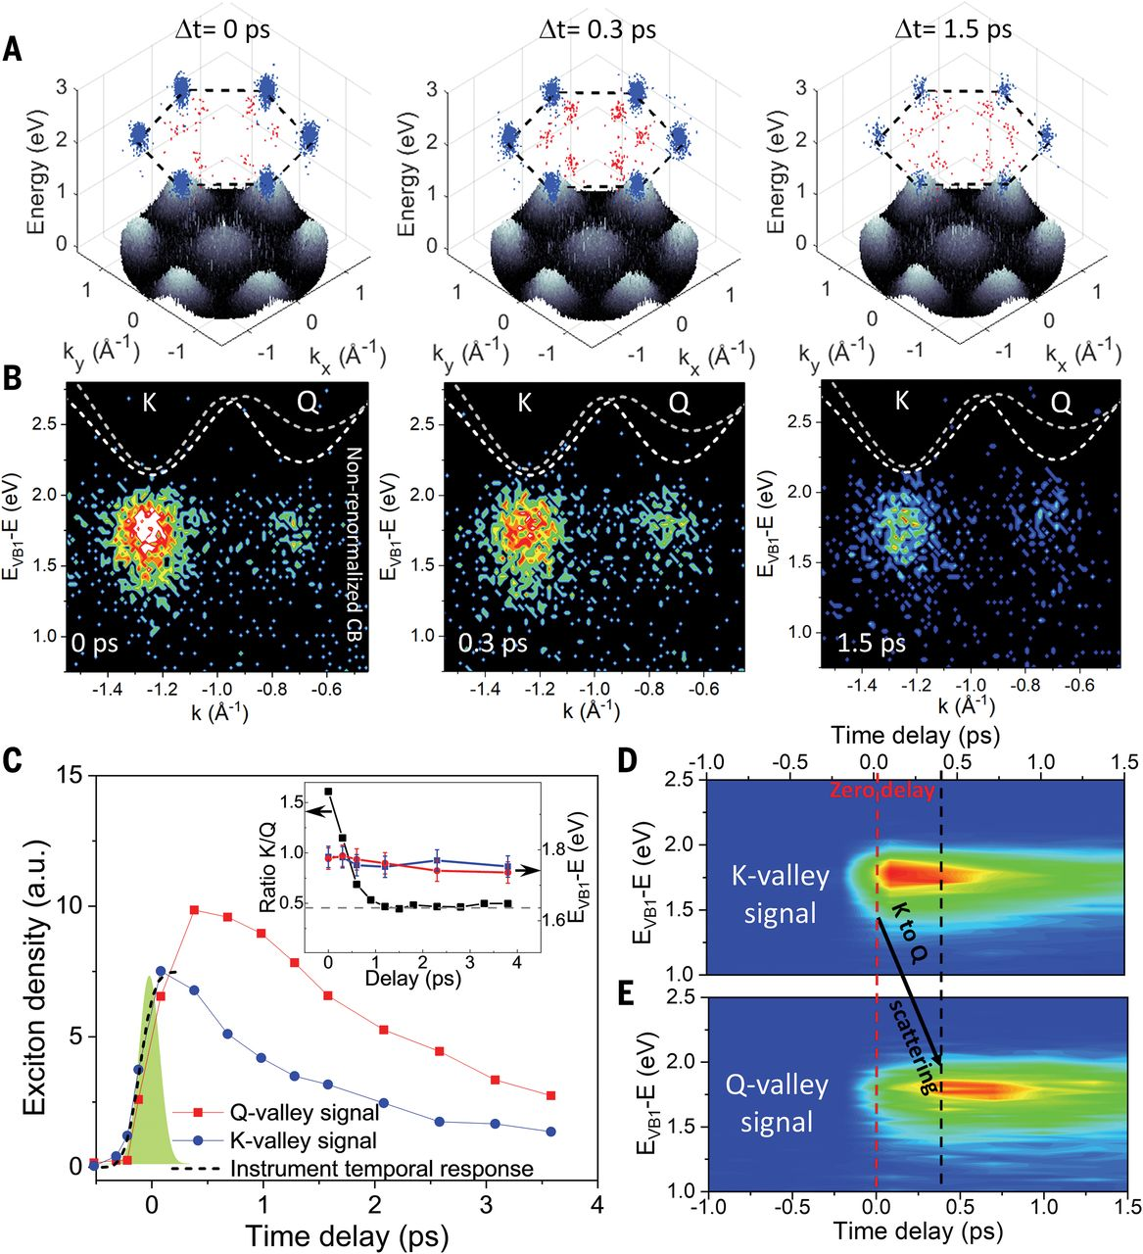
Direct detection of the electron constituent of a composite excitation
General theory of tr-ARPES

Slide 3
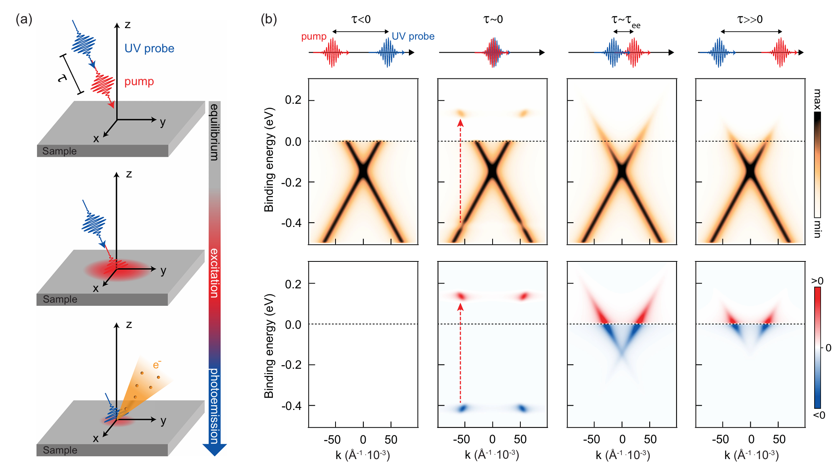
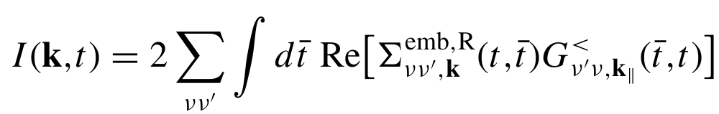
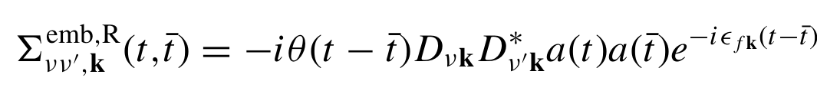
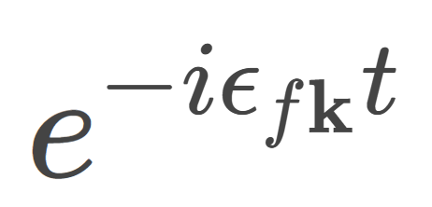
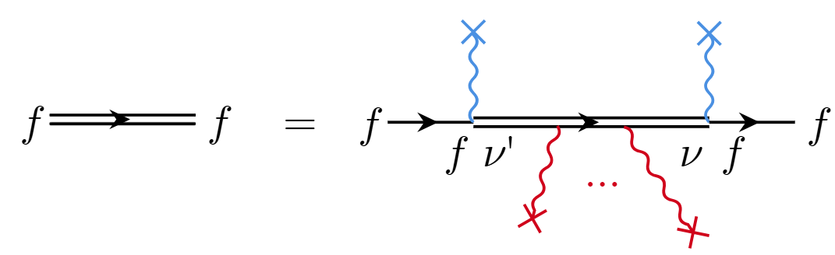
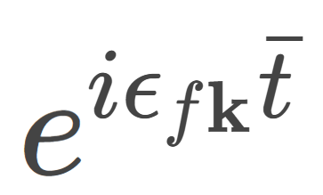
Theory of tr-ARPES
Theory in general: Keldysh EOM. Common scheme (e.g. PRB 94,245303, 2016):
Pump as a part of non-equilibrium EOM
Probe as perturbation on top of everything
RMP 96.1 2024: 015003

Slide 4
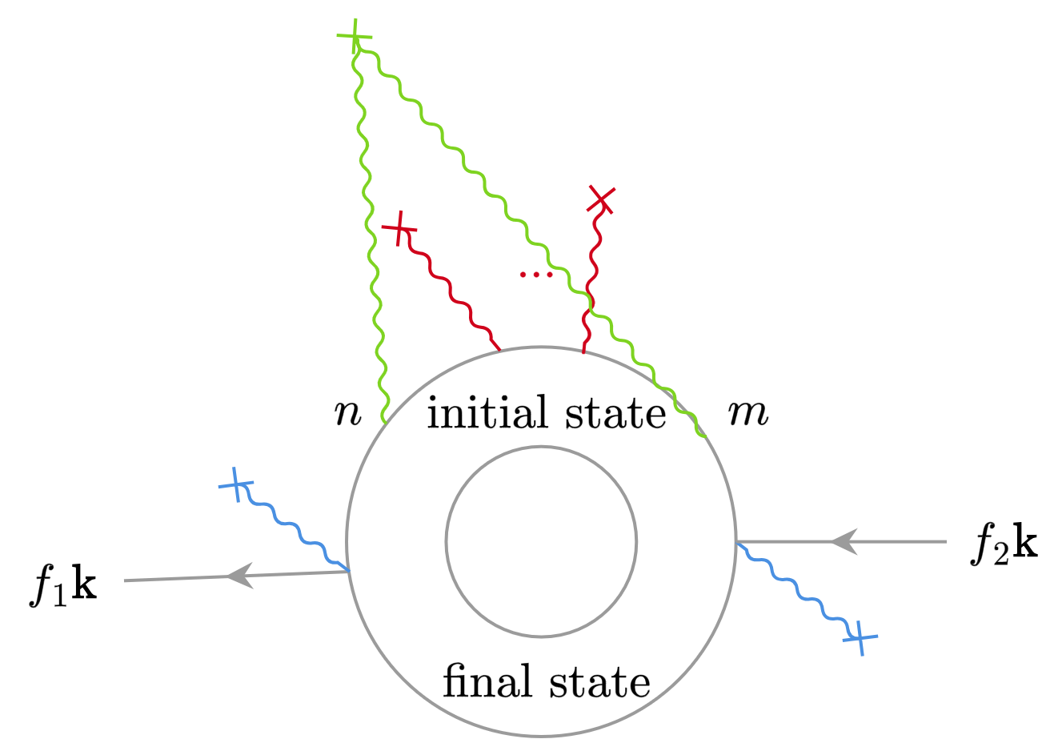
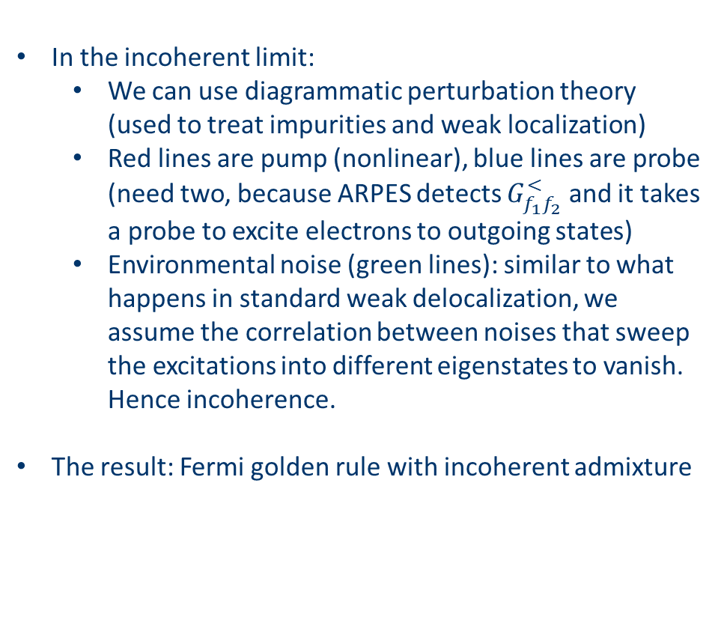
Theory of tr-ARPES
In the incoherent limit:
We can use diagrammatic perturbation theory (used to treat impurities and weak localization)
Red lines are pump (nonlinear), blue lines are probe (need two, because ARPES detects $G_{f_{1}f_{2}}^{<}$ and it takes a probe to excite electrons to outgoing states)
Environmental noise (green lines): similar to what happens in standard weak delocalization, we assume the correlation between noises that sweep the excitations into different eigenstates to vanish. Hence incoherence.
The result: Fermi golden rule with incoherent admixture

Slide 5
Theory of tr-ARPES
Discussed in this talk
Short delay time limit:
Good electronic coherence
Floquet renormalization
To be handled within coherent quantum master equation (e.g. PNAS 120.32 (2023): e2301957120)
Long delay time limit i.e. incoherent limit:
Decoherence
(Quasi-)thermalized electronic excitations

Slide 6
ARPES observation of excitons
Already done in experiments (Madéo et al., Science, 370(6521), pp.1199-1204)
Exciton Boltzmann transport observed (cf. theory in e.g. Chen et al. PR Research 2022 4(4):043203)

Slide 7
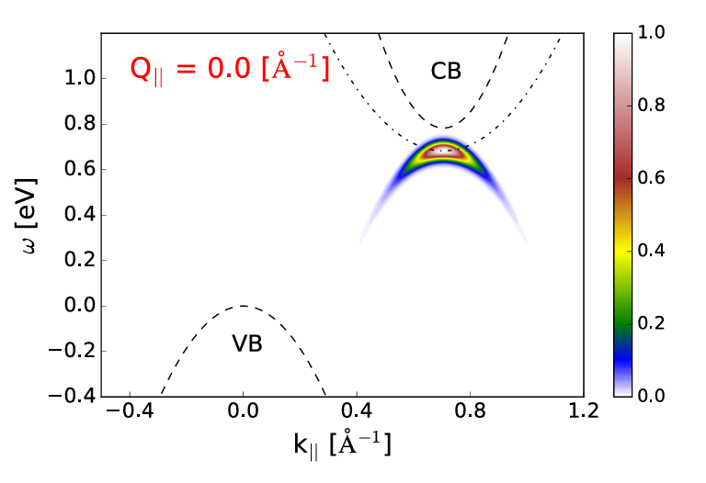
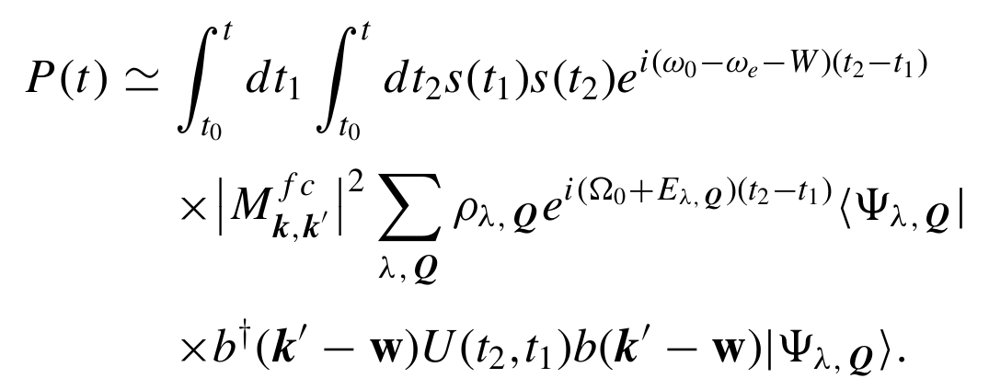
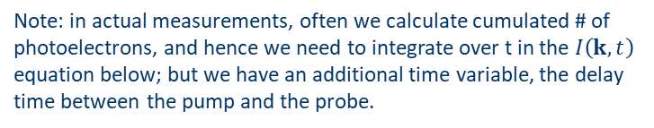

ARPES observation of excitons
Theory of exciton signature in ARPES: Rustagi and Kemper 2018 PRB 97, 235310
The $D^{∗}D$ term
Incoherent limit: no non-diagonal terms in density matrix
PRB 94,245303, 2016
Note: in actual measurements, often we calculate cumulated # of photoelectrons, and hence we need to integrate over t in the $I\left(k, t\right)$ equation below; but we have an additional time variable, the delay time between the pump and the probe.
How other excitations look like in ARPES?

Slide 8
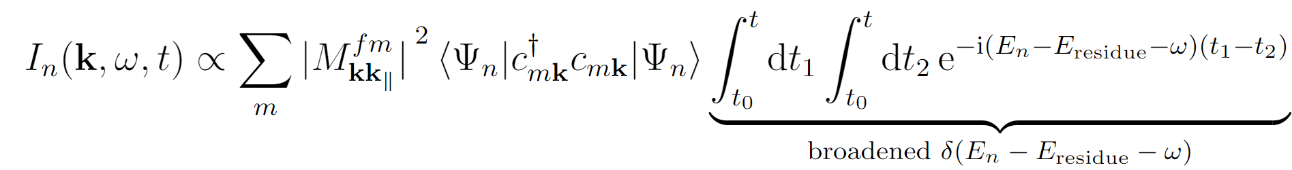
ARPES observation of excitons
To generalize the methodology in Rustagi and Kemper 2018 PRB 97, 235310:
What we can study:
Excitons √
Trions
Biexcitons
and more
Keldysh EOM
Linear response in detection
Generalized Fermi golden rule based on pumped $G^{<}$
Incoherent limit
Fermi golden rule to incoherent final states
structural factor
Energy conservation
Here the final residue states need to have well-defined energies… a condition that’s not always non-controversial

Slide 9
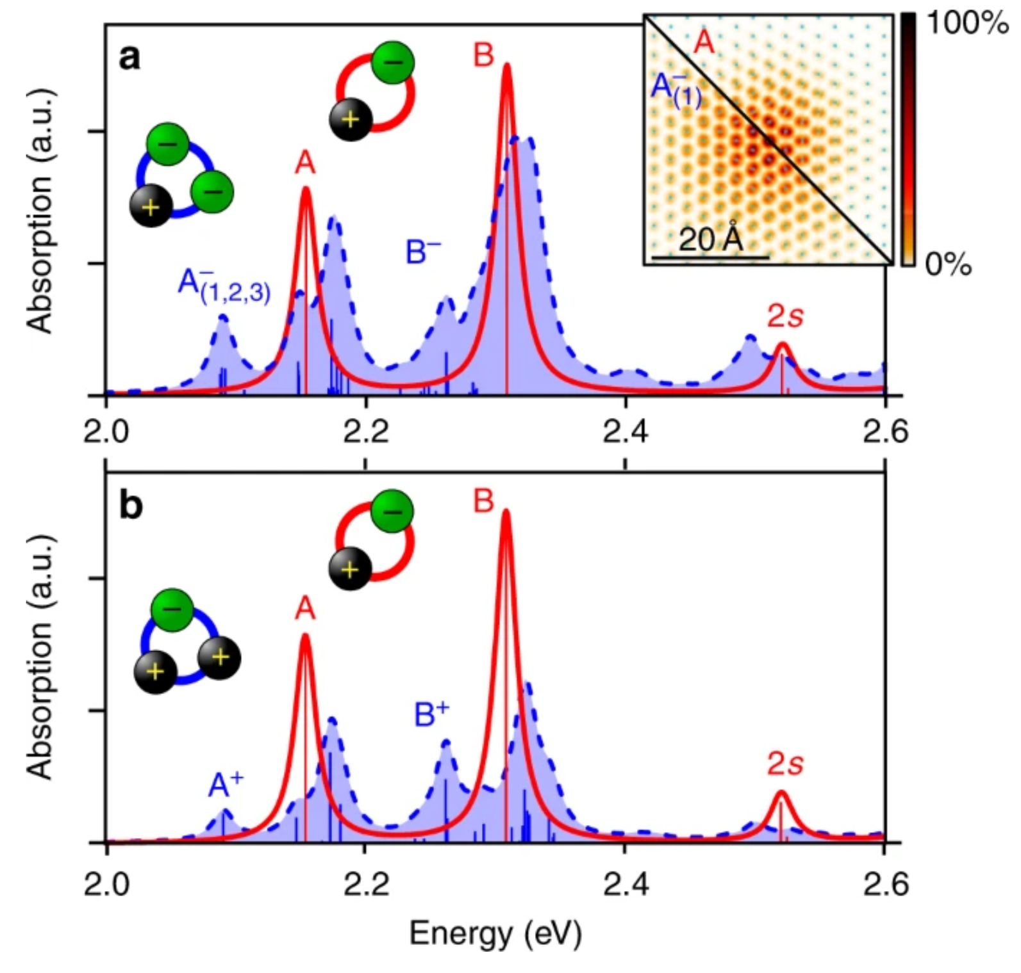
Where to look for these “charged excitons”?
Trions

Slide 10
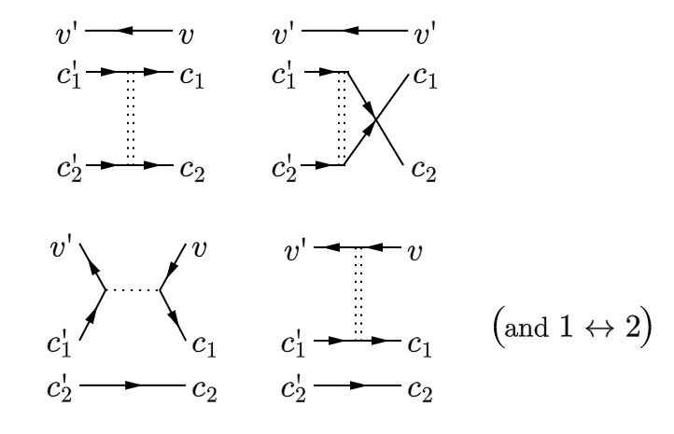
Trion structure: BSE prediction
Generalizing BSE for excitons to trions: Druppel et al. Nat. Comm. 8 2117 (2017)
Difference from exciton BSE: the “exchange” term between two electrons (cf. u-channel in particle physics)
“The diagonalization of the trion Hamilton matrix is numerically extremely demanding due to the immense dimension of ~107 for a typical calculation and relies on recursive diagonalization schemes”

Slide 11
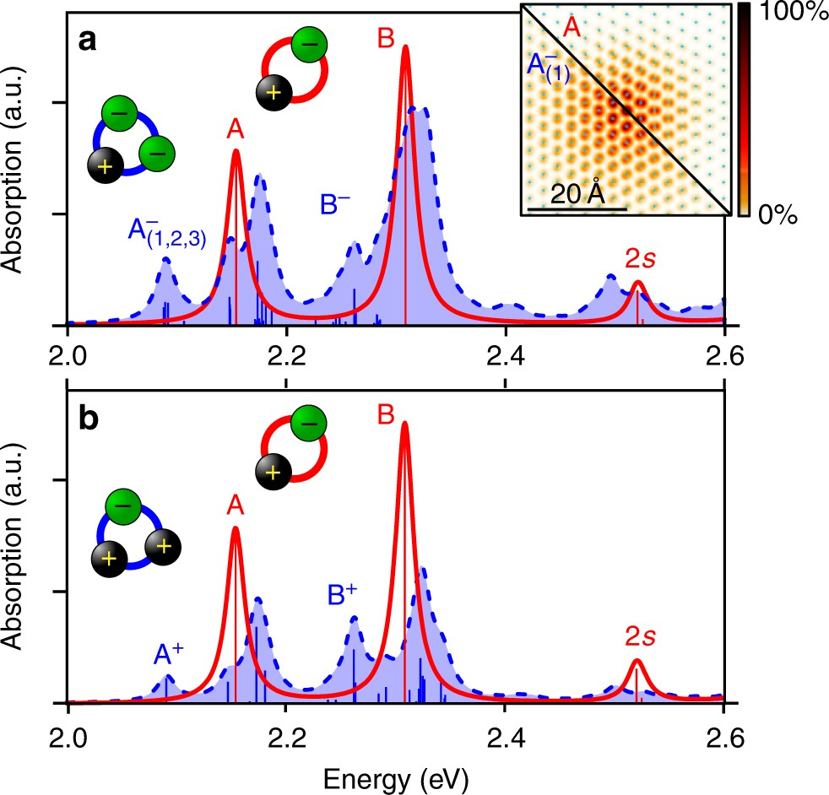
Trion structure: BSE prediction
Generalizing BSE for excitons to trions: Druppel et al. Nat. Comm. 8 2117 (2017)
Material: monolayer MoS₂
Prediction: emergence of low-frequency peaks in absorption spectrum
Question: how do they look like in ARPES?

Slide 12
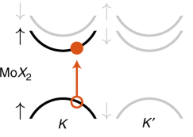
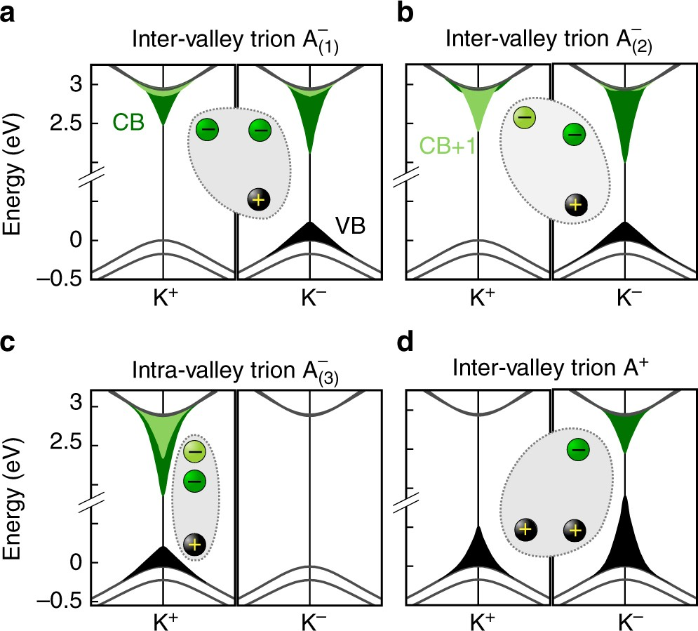
Trion: wave function structure
Generalizing BSE for excitons to trions: Druppel et al. Nat. Comm. 8 2117 (2017)
Valleytronics in monolayer MoS₂: spin-valley locking
Being an intervalley state reduces Coulomb repulsion
Spin singlet state reduces exchange term
Thus: the lowest trion modes are
Intervalley,
Singlet states (Nat Commun 10, 3419 (2019))
a
b

Slide 13
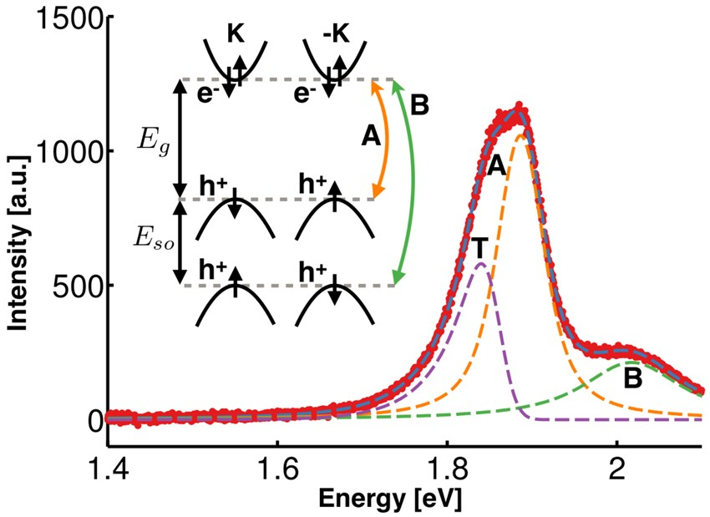
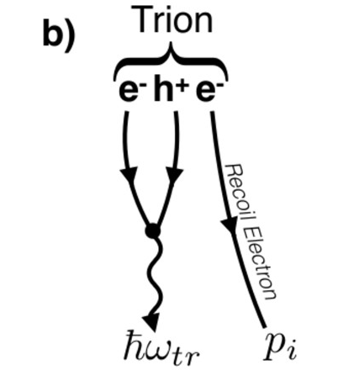
Observation of trions
E.g. Nature Mater 12, 207–211 (2013), Sci Rep 7, 14062 (2017)
Photoluminescence peaks of trions are always asymmetric, with a soft lower edge (because after recombination, some energy is distributed to the remaining electron)

Slide 14
First-principles calculation is too slow…
This project:
Two-band model
Analytic theory of (incoherent) tr-ARPES
Methodology of this project

Slide 15
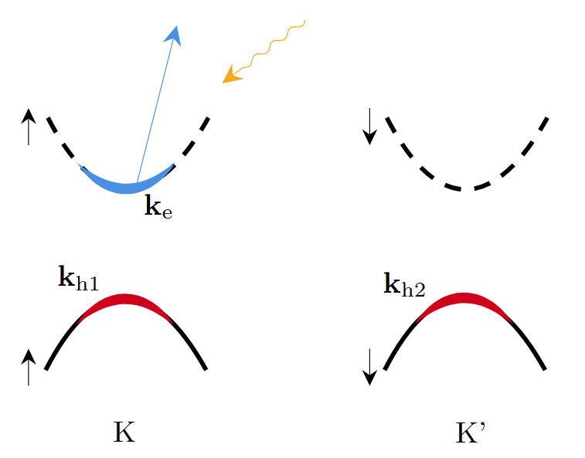
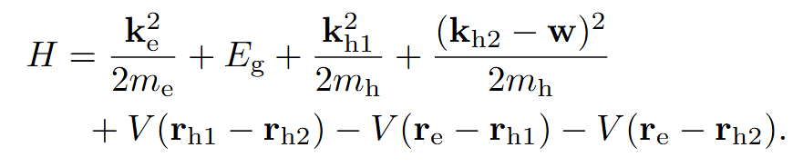

Trion structure: from trion BSE to two-band model
Generalizing BSE for excitons to trions: Druppel et al. Nat. Comm. 8 2117 (2017)
Thus: the lowest trion modes are
Intervalley,
Singlet states (Nat Commun 10, 3419 (2019))
Effective theory of the lowest trion (ehh or eeh): two-band model about how far quasiparticles go from the valleys
Exchange term ignored: its most important effect is formation of singlet state
$$w$$
Which we can solve by the Chandrasekhar ansatz (symmetric √ because the spin-valley part is antisymmetric) for helium atom, after some clever coordinates transform

Slide 16
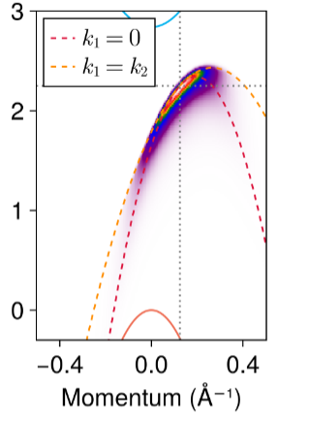
Theory of tr-ARPES for trions
Keldysh EOM
Linear response in detection
Generalized Fermi golden rule based on pumped $G^{<}$
Incoherent limit
Fermi golden rule to incoherent final states
Trion states
Assumption: non-interactive final states (not correct, but doesn’t change the shape of the dispersion relation)

Slide 17
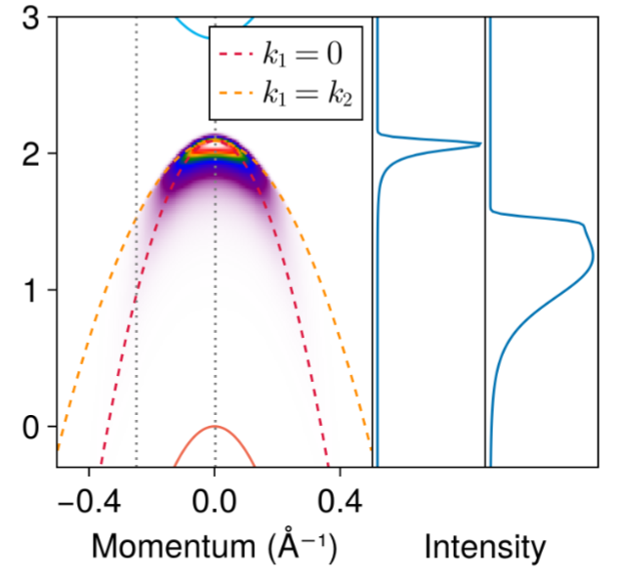
Comparison of signature of a positive trion with that of an exciton
Positive trion

Slide 18
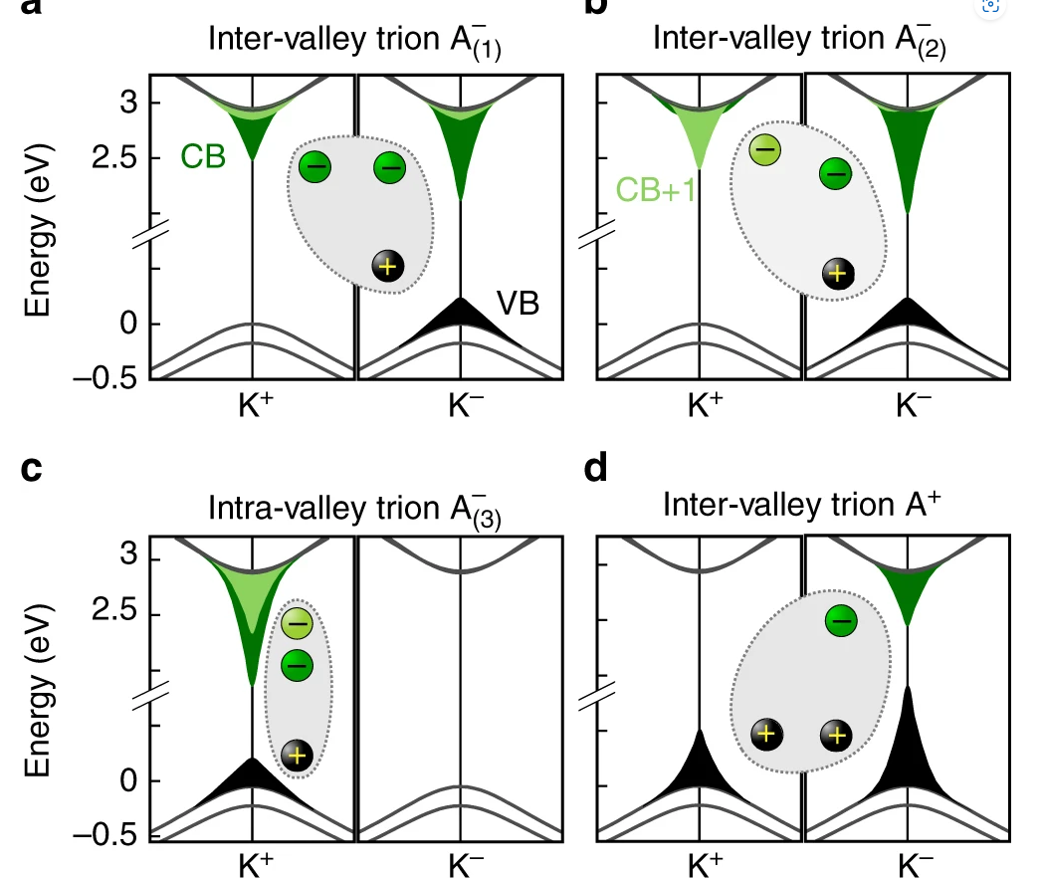
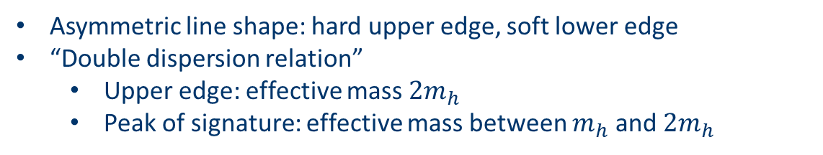
ehh, i.e. positive trion: main results
To ARPES detector
Initial state: trion
Final state: two holes (assuming there is no interaction)
Asymmetric line shape: hard upper edge, soft lower edge
“Double dispersion relation”
Upper edge: effective mass $2m_{h}$
Peak of signature: effective mass between $m_{h}$ and $2m_{h}$

Slide 19
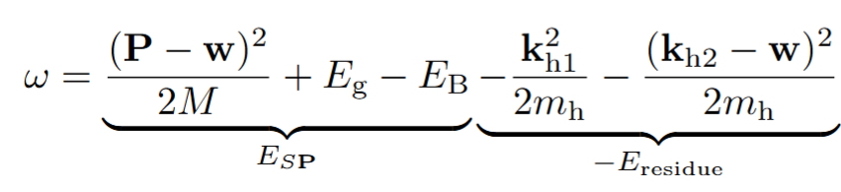
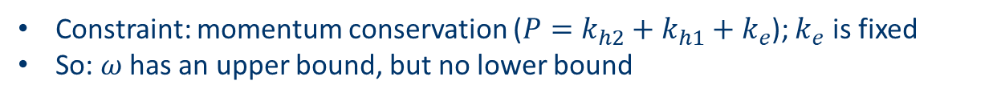
ehh, i.e. positive trion: line shape
To ARPES detector
Initial state: trion
Final state: two holes (assuming there is no interaction)
The lineshape at a given momentum now is asymmetric
Hard upper edge
Soft lower edge
Why? The allowed output electron energies:
Constraint: momentum conservation ($P=k_{h2}+k_{h1}+k_{e}$); $k_{e}$ is fixed
So: $ω$ has an upper bound, but no lower bound

Slide 20
ehh, i.e. positive trion: where is the peak
To ARPES detector
Initial state: trion
Final state: two holes (assuming there is no interaction)
The frequency where intensity is highest is not the upper edge
Let’s inspect FGR
Structural factor
Energy conservation relation determines a subspace in momentum space
We want the subspace to collect as much structural factor weight as possible to

Slide 21
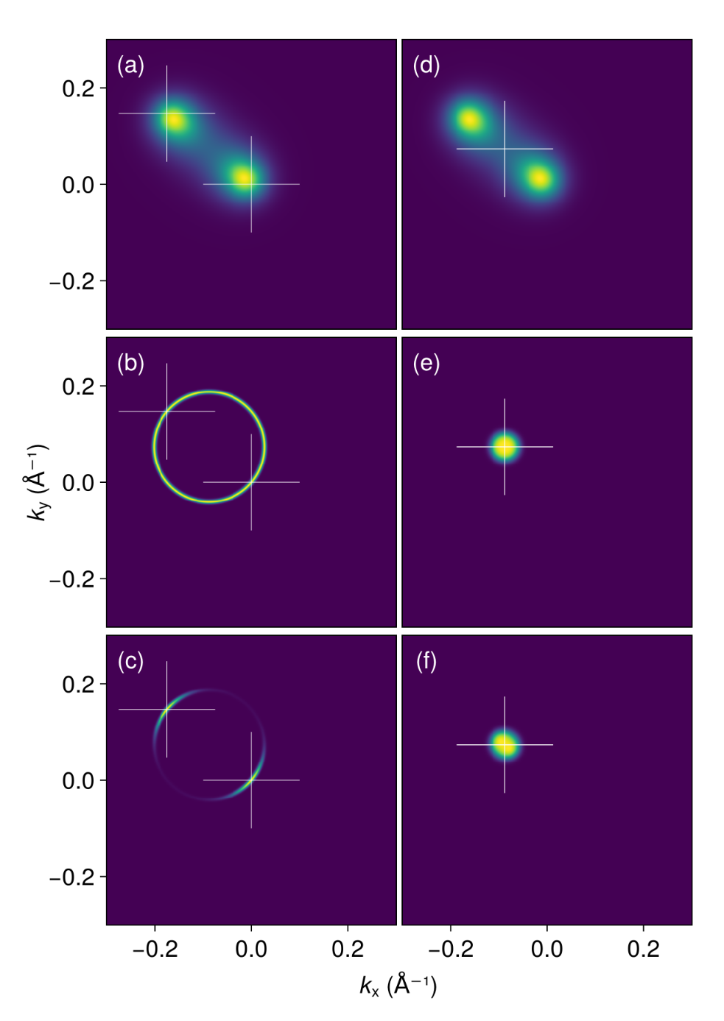
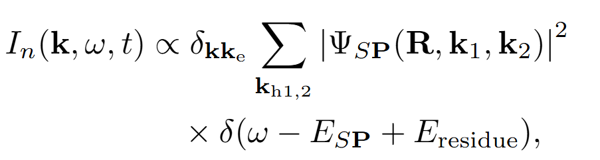
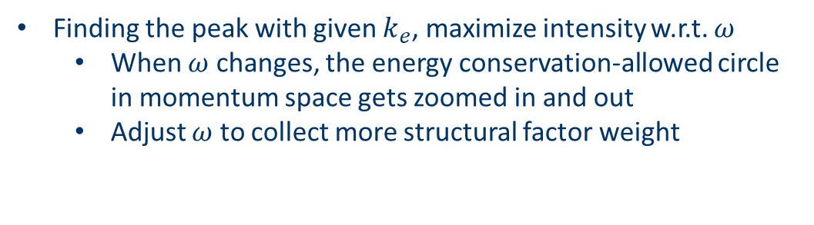
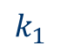
ehh, i.e. positive trion: where is the peak
Finding the peak with given $k_{e}$, maximize intensity w.r.t. $ω$
When $ω$ changes, the energy conservation-allowed circle in momentum space gets zoomed in and out
Adjust $ω$ to collect more structural factor weight
Trion structural factor
Energy conservation allowed momenta
Weight collected
Maximization of ARPES intensity: let the energy conservation circle collects as much weight as possible
$$k_{1}$$

Slide 22
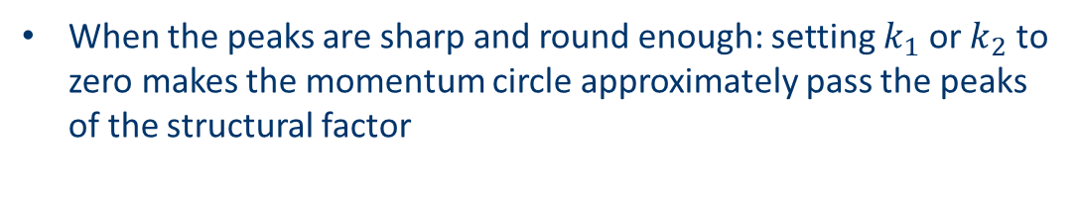
ehh, i.e. positive trion: where is the peak
Finding the peak with given $k_{e}$, maximize intensity w.r.t. $ω$
When $ω$ changes, the energy conservation-allowed circle in momentum space gets zoomed in and out
Adjust $ω$ to collect more structural factor weight
Trion structural factor
When the peaks are sharp and round enough: setting $k_{1}$ or $k_{2}$ to zero makes the momentum circle approximately pass the peaks of the structural factor
Energy conservation allowed momenta
Weight collected
$$k_{1}$$

Slide 23
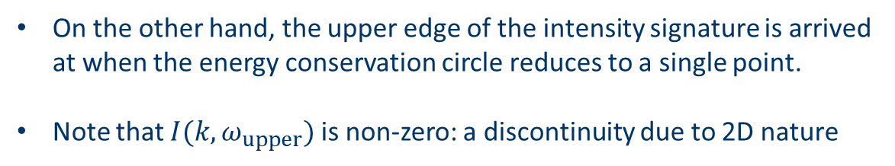
ehh, i.e. positive trion: where is the peak
Finding the peak with given $k_{e}$, maximize intensity w.r.t. $ω$
When $ω$ changes, the energy conservation-allowed circle in momentum space gets zoomed in and out
Adjust $ω$ to collect more structural factor weight
Trion structural factor
On the other hand, the upper edge of the intensity signature is arrived at when the energy conservation circle reduces to a single point.
Note that $I(k,ω_{upper})$ is non-zero: a discontinuity due to 2D nature
Energy conservation allowed momenta
Weight collected
$$k_{1}$$

Slide 24
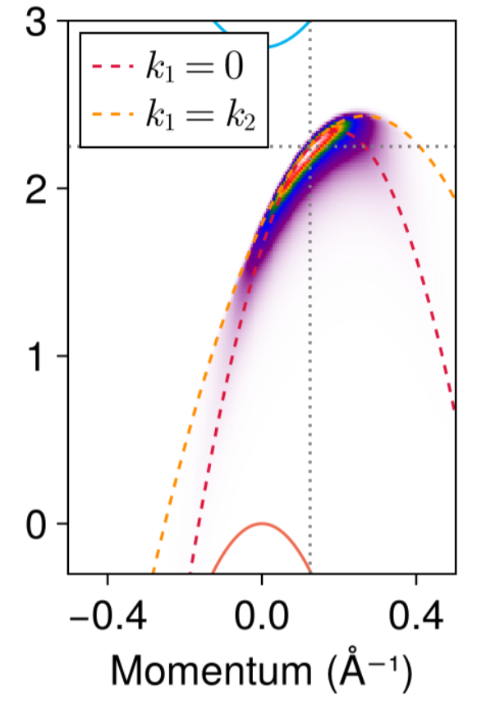
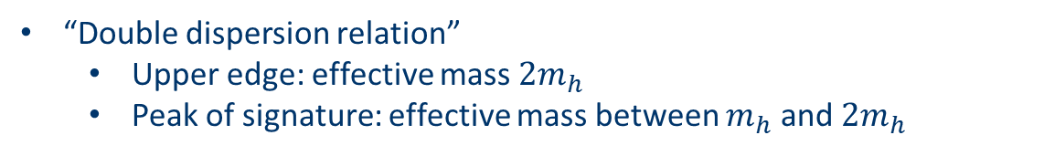
To ARPES detector
ehh, i.e. positive trion: finite momentum
Initial state: trion
Final state: two holes (assuming there is no interaction)
All major features remain
“Double dispersion relation”
Upper edge: effective mass $2m_{h}$
Peak of signature: effective mass between $m_{h}$ and $2m_{h}$
Asymmetric line shape: hard upper edge, soft lower edge

Slide 25
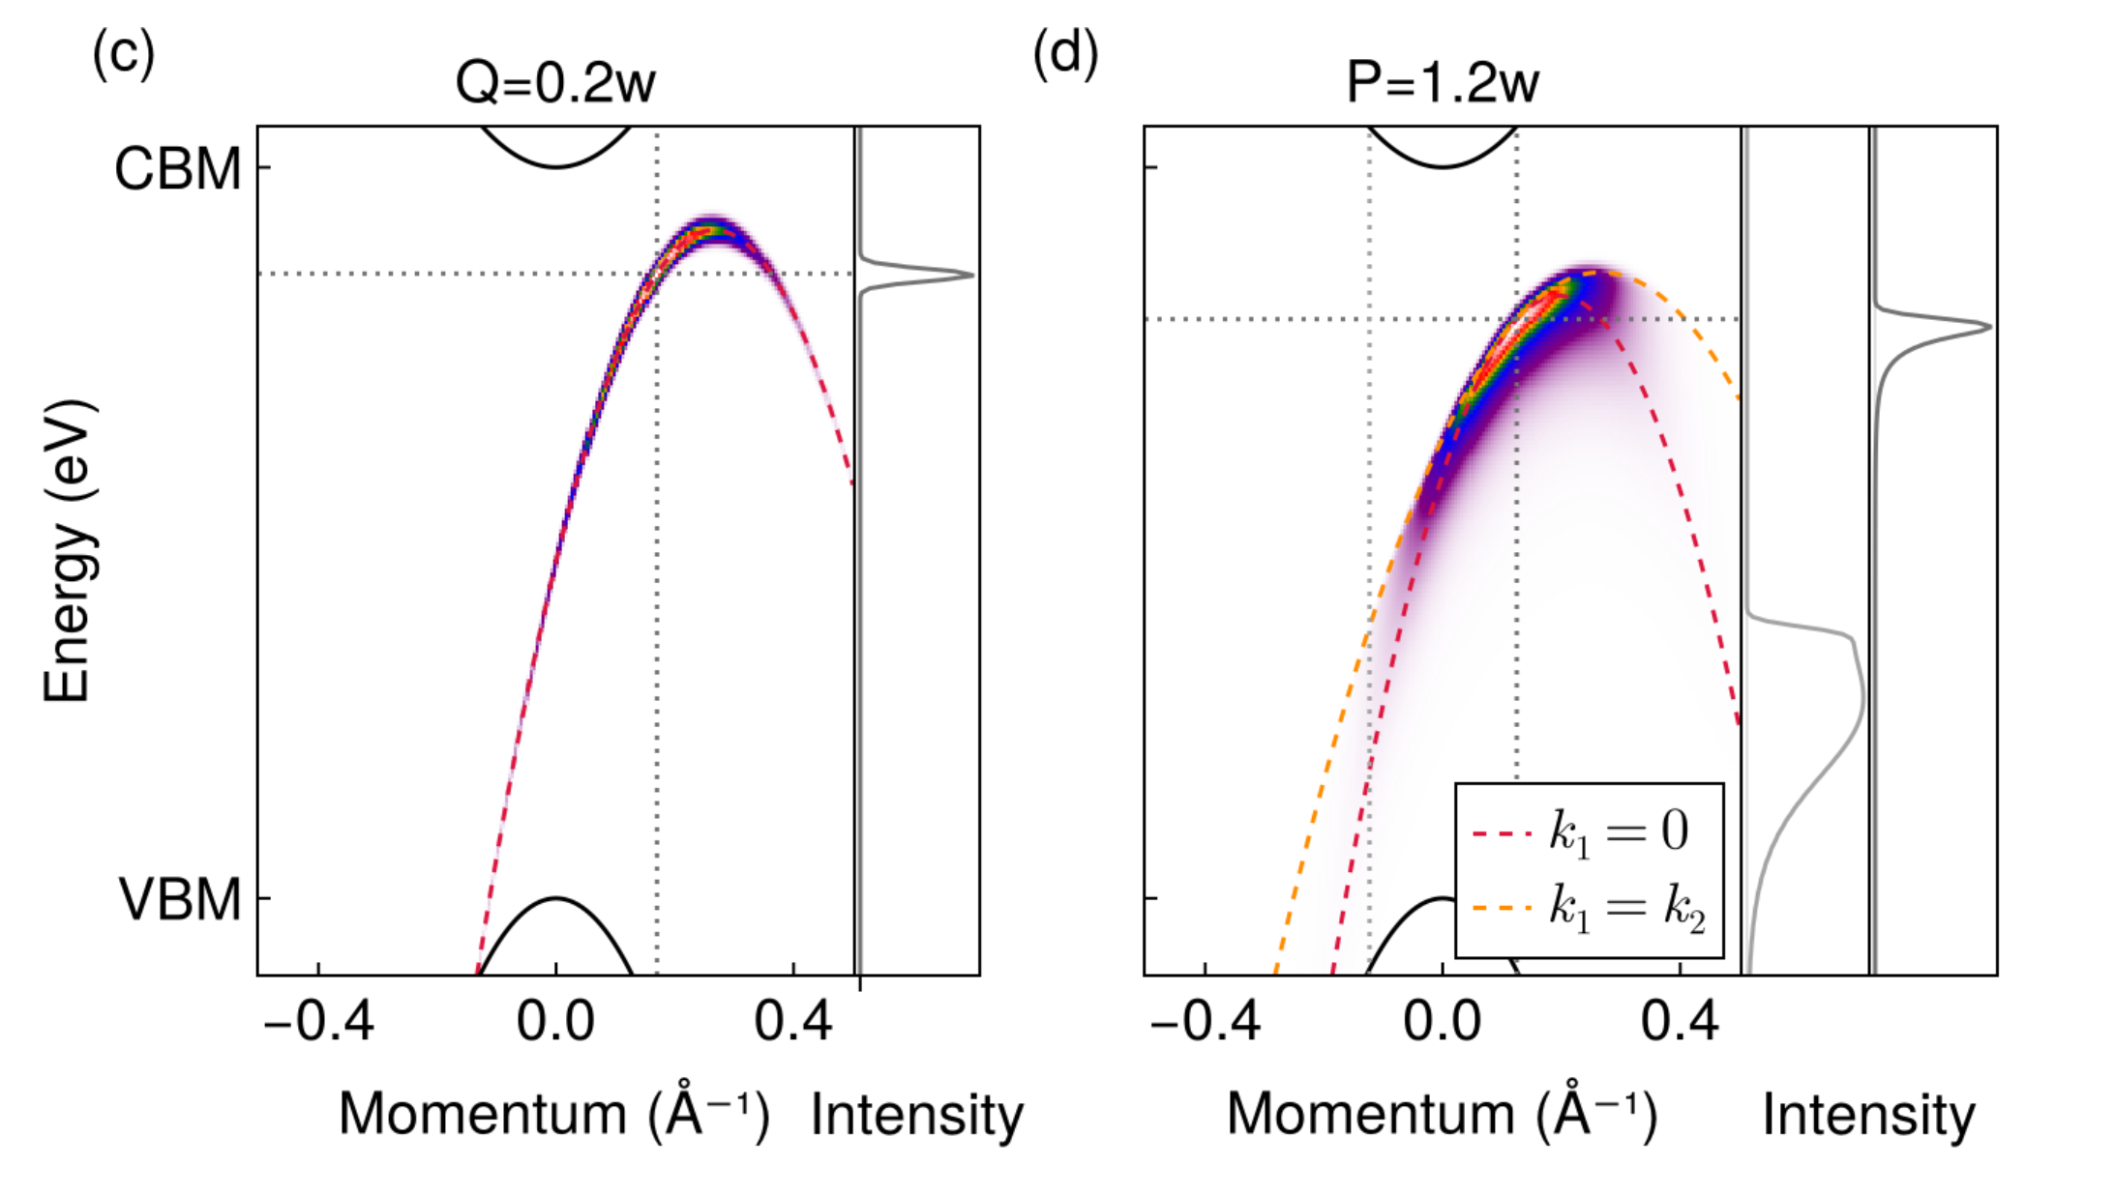
ehh, i.e. positive trion: finite momentum
Comparison with finite momentum exciton
Different line shape, curvature, global intensity maximum…

Slide 26
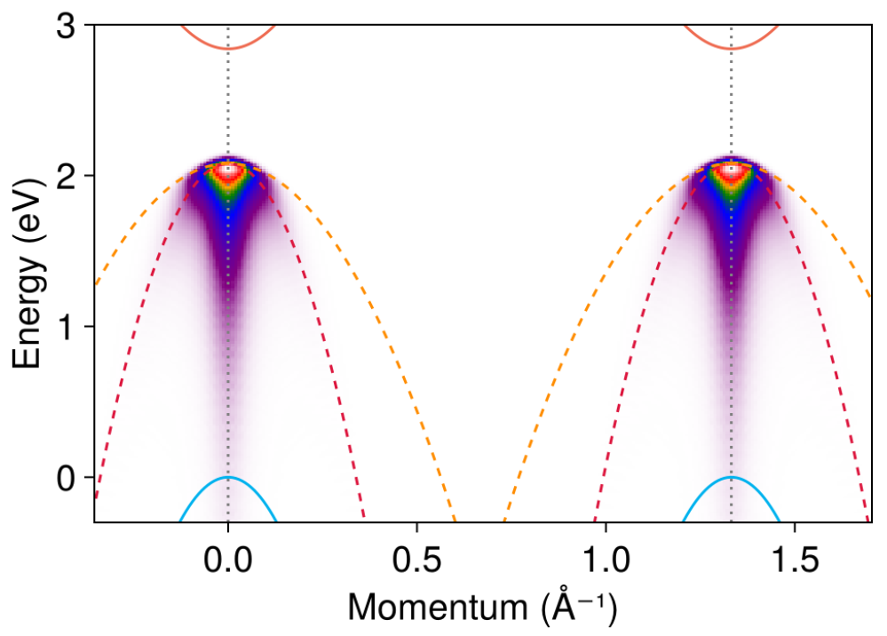
Comparison of signature of a negative trion with that of an exciton
Negative trion (weakly bound final states)

Slide 27
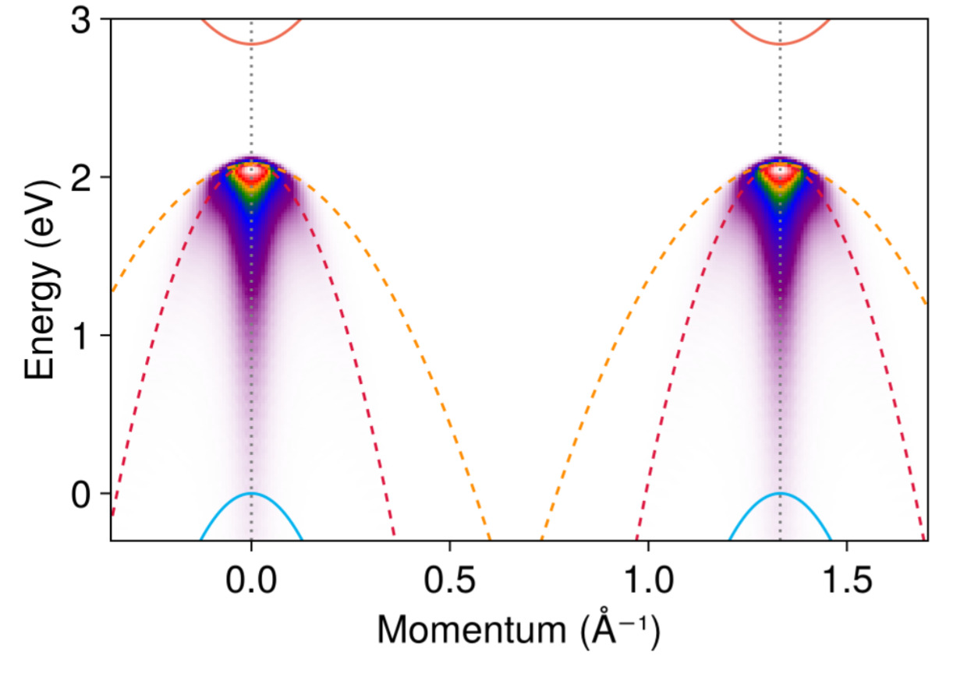
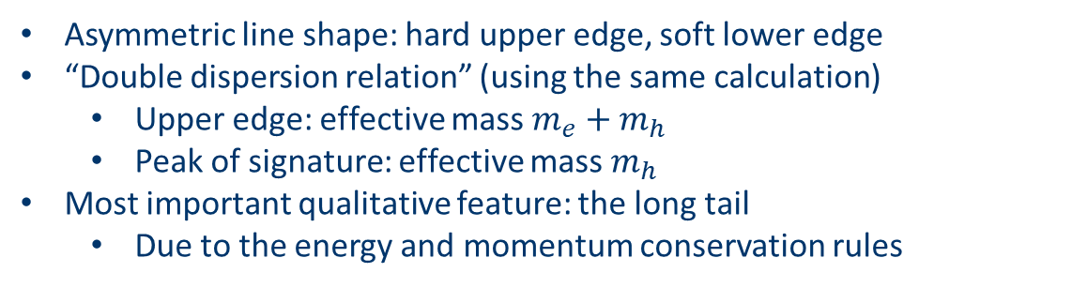
To ARPES detector
To ARPES detector
eeh, i.e. negative trion: main results
or
Initial state: trion
Final state: electron and hole (assuming there is no interaction)
Asymmetric line shape: hard upper edge, soft lower edge
“Double dispersion relation” (using the same calculation)
Upper edge: effective mass $m_{e}+m_{h}$
Peak of signature: effective mass $m_{h}$
Most important qualitative feature: the long tail
Due to the energy and momentum conservation rules

Slide 28
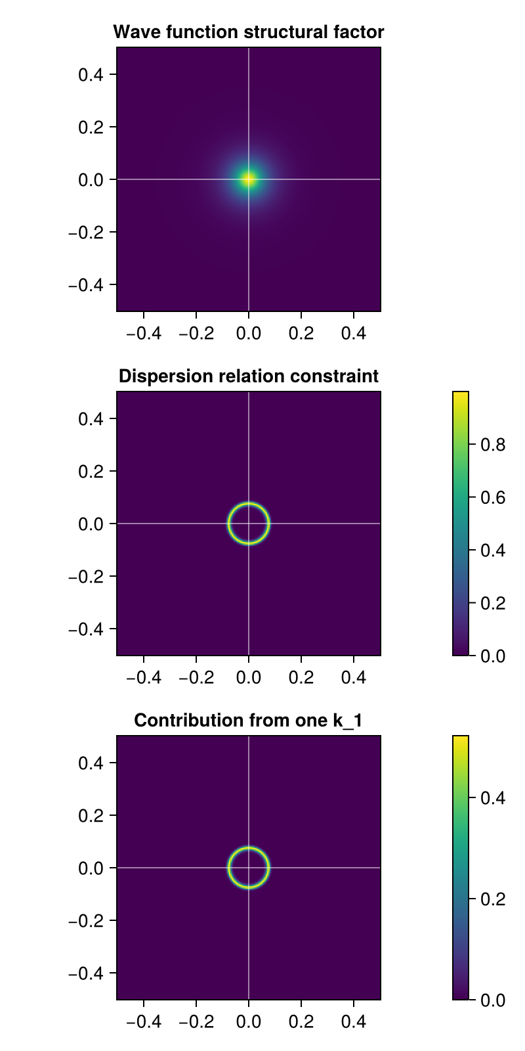
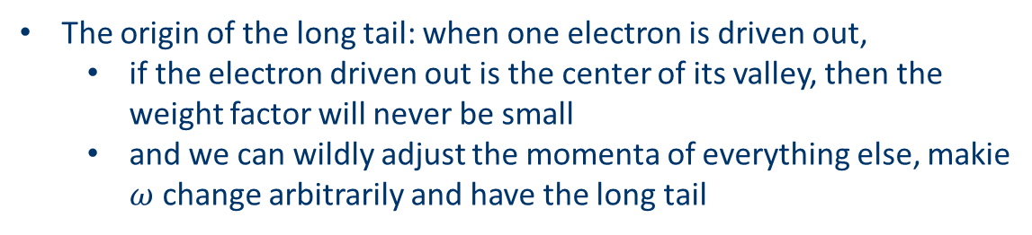
To ARPES detector
To ARPES detector
eeh, i.e. negative trion: origin of the long tail
or
What’s the origin?
The origin of the long tail: when one electron is driven out,
if the electron driven out is the center of its valley, then the weight factor will never be small
and we can wildly adjust the momenta of everything else, makie $ω$ change arbitrarily and have the long tail

Slide 29
eeh, i.e. negative trion: the double signatures
Two electrons 👉 two peaks
The most unmistakable feature
To ARPES detector
To ARPES detector
or

Slide 30
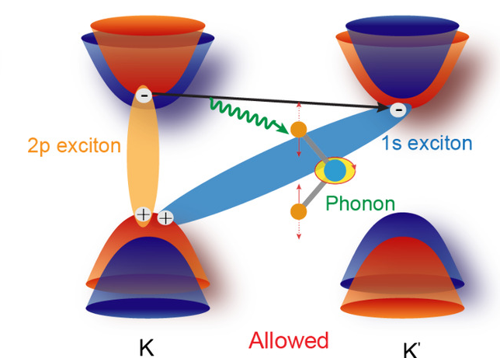
eeh, i.e. negative trion: the double signatures
Two electrons 👉 two peaks
The most unmistakable feature… or is it?
Consider K-K’ scattering:
And this results in one peak at K and another at K’ at well…
But in the trion case, the two peaks appear instantly

Slide 31
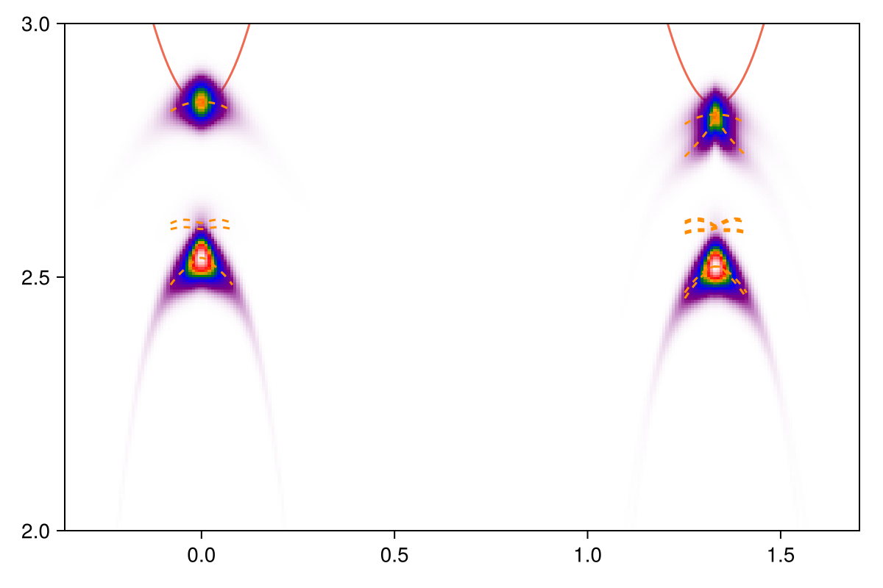
Comparison of signature of a negative trion with that of an exciton
Negative trion (excitonic final states)

Slide 32
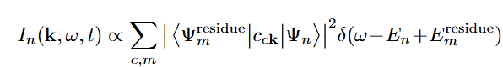
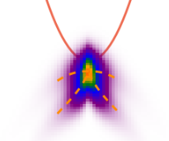
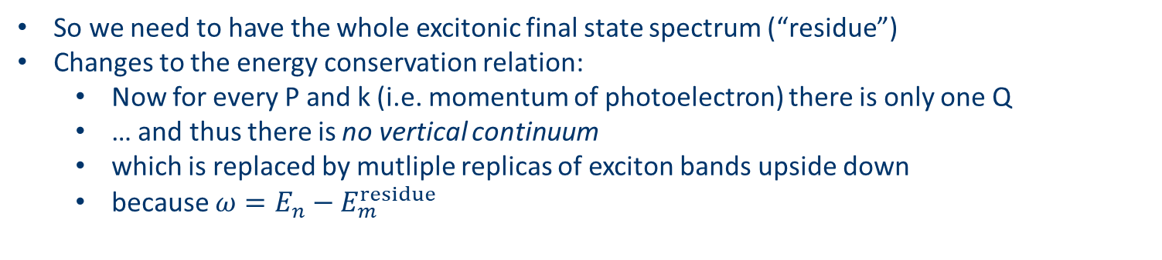
What happens when the final states are excitonic?
Without the non-interaction final state assumption:
So we need to have the whole excitonic final state spectrum (“residue”)
Changes to the energy conservation relation:
Now for every P and k (i.e. momentum of photoelectron) there is only one Q
… and thus there is no vertical continuum
which is replaced by mutliple replicas of exciton bands upside down
because $ω=E_{n}−E_{m}^{residue}$
fixed

Slide 33
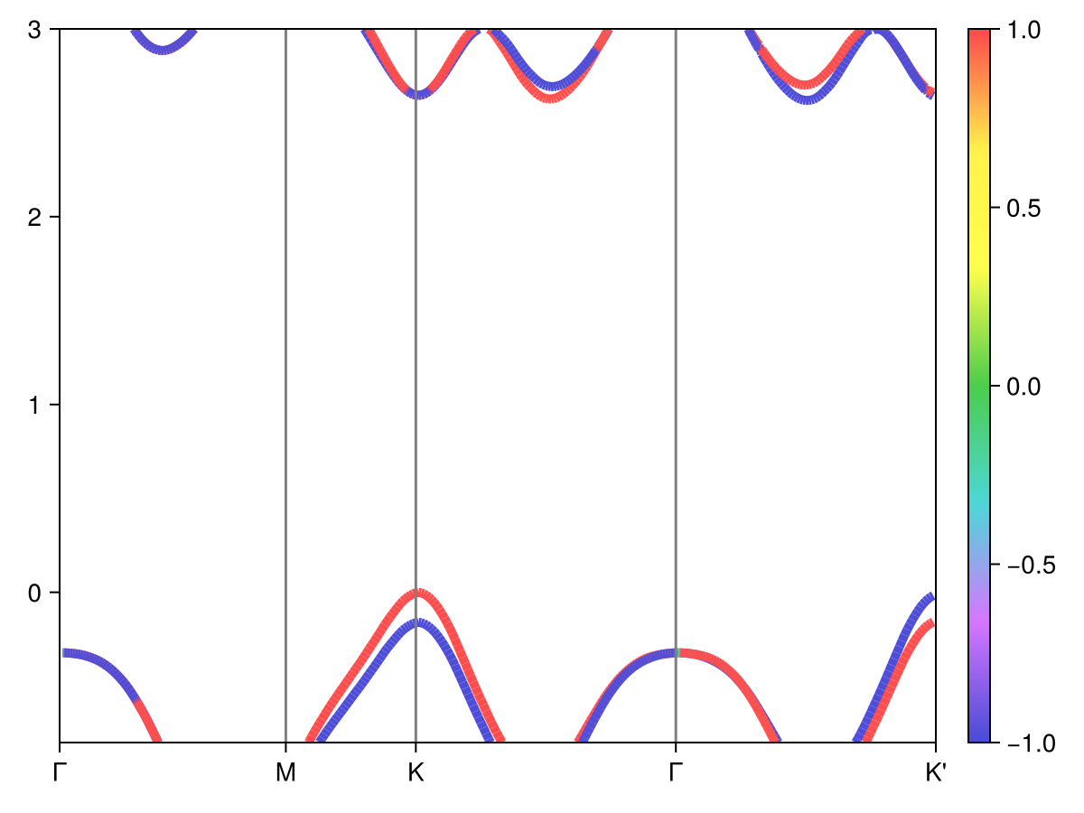
Classification of excitonic states in MoS2
/pscratch/sd/j/jywu/MoS2/MoS2/2-sigma-cutoff-20/inteqp/dft-spin-texture-gw.png
At K,
v1 is spin-up
v2 is spin-down
Near a patch (smaller than the excitonic patch)
c1 is spin-up
c2 is spin-down
Away from the patch
c1 is spin-down
c2 is spin-up
We need to re-arrange the band indices if we want the properties of a single band to be smooth
Pay attention to the band crossing here!!

Slide 34
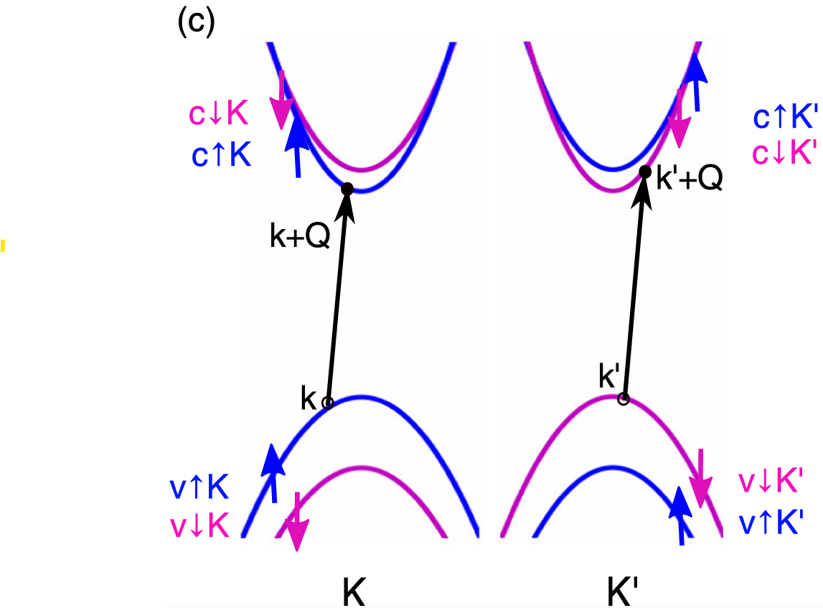
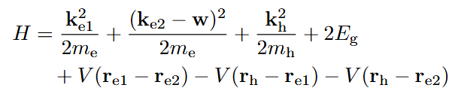

Classification of excitonic states in MoS2
We need to re-arrange the band indices if we want the properties of a single band to be smooth (see colors of bands in the figure on the right)
These are bands used in the two-band model for trions
Note that the band indices in the output of BGW are based on energy only
So a conversion is needed:
v1c1
v1c2
v↑c↑
https://journals.aps.org/prl/pdf/10.1103/PhysRevLett.115.176801
We only have weight outside the band crossing patch, meaning that this is a up-to-up transition
/pscratch/sd/j/jywu/Trion-arpes/simplified/exciton-0-patch-2.png

Slide 35



Classification of excitonic states in MoS2
Bands in lowest excitons in valleytronic materials are all spin-polarized
Strong valley-spin locking
In a single valley, there is no v↑c↑-v↓c↓ degeneracy
There is no singlet-triplet split, but like-spin/unlike-spin split
Therefore we have the following exciton series in each valley when Q=0:
A series, from v↑ to c↑ or c↓
v↑c↑, i.e. like-spin A exciton (A optical exciton)
v↑c↓, i.e. unlike-spin A exciton (optically dark)
Separated by exchange interaction
B series, from v↓ to c↑ or c↓, separated from A series by SOC
v↓c↓, i.e. like-spin B exciton (B optical exciton)
v↓c↑, i.e. unlike-spin B exciton (optically dark)
Separated by exchange interaction
We have 1s, 2p, etc. states (corresponding to k index) for bright A, dark A, etc states (so called A’, B’ states, corresponding to the band indices)
unlike-spin
like-spin
https://journals.aps.org/prl/pdf/10.1103/PhysRevLett.115.176801
$$A_{vck }$$
https://journals.aps.org/prl/pdf/10.1103/PhysRevLett.111.216805

Slide 36


Exciton band structure, $Q≈Γ$
Only A series is considered in this figure
The 1s, 2p, etc. index corresponds to the internal momentum variable
K, K’ degeneracy
No K-K’ degeneracy when Q=K
Like-spin bands hybridized by exchange interaction between K and K’
Unlike spin bands, no exchange-led degeneracy breaking
https://journals.aps.org/prl/pdf/10.1103/PhysRevLett.115.176801

Slide 37

Exciton band structure , $Q≈Γ$: phase problem
One more thing: the phase factor
???? possible phase interference
Note that the real part of the wave function has random positive and negative values, because each single-electron wave function has a random phase factor in DFT diagonalization
The crux: random phase factor w.r.t. k (not band indices as we only have two bands in question)
Assuming the 1s wave function is mostly “real”, we may want to use it as a point of reference…
/pscratch/sd/j/jywu/Trion-arpes/simplified/exciton-0-patch-2.png, aeba749e

Slide 38



Exciton band structure, $Q≈Γ$: phase problem
How to read an exciton wave function
/pscratch/sd/j/jywu/Trion-arpes/simplified/eeh-heatmap-prototype-discrete-final-zoom-in.jl
Avck is directly from eigenvectors.h5
The 2nd exciton is the bright A 1s exciton
Solving band crossing issue
Assuming the A 1s wave function is real, correcting the phase factors at each k
Eliminate the global phase factor
Wave function read in naïve way
The 3rd like-spin state in single valley: a 2p state
Note that this algorithm can only correct phases of A series like-spin excitons: other exciton series need to be corrected according to their own 1s states
/pscratch/sd/j/jywu/Trion-arpes/simplified/exciton-0-patch-6.png

Slide 39


Exciton band structure, $Q≈Γ$
Hilbert space: (A, B)×(like-spin, unlike-spin)×(K, K’)×“hydrogen” quantum numbers ; only A excitons are shown here
https://journals.aps.org/prl/pdf/10.1103/PhysRevLett.115.176801
The exciton wave functions are indeed real: it can be verified that the norm of the real part (after phase factor corrections) is around 1 for all states
/pscratch/sd/j/jywu/Trion-arpes/simplified/exciton-0-patch-10.png, etc.

Slide 40



Pairing spinor calculation with spin polarized calculations
The data we have in hands, when Q is close to Γ:
Data in https://journals.aps.org/prl/pdf/10.1103/PhysRevLett.115.176801, band plot only, no wave function
Patched sampled BSE data, with wave functions, but not Q-resolved
Matching the two:
Correspondence between states:
Valley-specific patched sampling contains no K’ components
The like-spin-polarized calculation contains no unlike-spin states; the unlike-spin-polarized calculation contains no like-spin states
The spin-polarized calculations by Qiu et al. have no B states
2 A 2s states
4 A 2p states (2 like-spin ones, 2 unlike-spin ones)
2 B 1s states
2 A 1s states; no K’ states

Slide 41


Pairing spinor calculation with spin polarized calculations
The data we have in hands, when Q is close to Γ:
Data in https://journals.aps.org/prl/pdf/10.1103/PhysRevLett.115.176801, band plot only, no wave function
Patched sampled BSE data, with wave functions, but not Q-resolved
Matching the two:
When Q is not exactly 0, exchange interaction between K and K’ transitions is non-zero:
But for 1s and 2s states it’s just adding a $σ^{x}$ term to the two-level Hamiltonian, and the K and K’ components are always mixed in a 50-50 ratio
The 2p states are not active because of selection rules (symmetric trion wave function can’t transition to antisymmetric exciton wave function)

Slide 42




Pairing spinor calculation with spin polarized calculations
There is however an issue in calculating the $Q≈K$ excitons
/pscratch/sd/j/jywu/MoS2/MoS2/4-absorption-120-no-sym-gw-K/eigenvalues.dat
Why the transition matrix element from ground state to lowest exciton (note: here the dipole matrix is just transition matrix) is non-zero?
The lowest exciton band is unlike-spin!!!
v1c1
v1c2
Somehow my calculation says the lowest exciton is like-spin
Exchange term only applies to like-spin transitions and is usually positive; there is a theoretical problem here
https://journals.aps.org/prl/pdf/10.1103/PhysRevLett.115.176801
/pscratch/sd/j/jywu/Trion-arpes/simplified/exciton-0-patch-1.png

Slide 43


Comparison between Γ and K excitons
Although there is the problem of order of bands, the wave functions are remarkably similar
Both are hydrogen-like enough
/pscratch/sd/j/jywu/Trion-arpes/simplified/exciton-0-patch-10.png
/pscratch/sd/j/jywu/Trion-arpes/simplified/exciton-K-patch-10.png

Slide 44


Residue after photoemission
Photoemission from K’: residue state is like-spin
Photoemission from K: residue state is unlike-spin
Select final states accordingly
https://journals.aps.org/prl/supplemental/10.1103/PhysRevLett.115.176801/supplemental.pdf

Slide 45


Results
Photoemission from K’: residue state is like-spin
Photoemission from K: residue state is unlike-spin
Select final states accordingly
A 1s unlike-spin
A 1s like-spin
A 2p unlike-spin
A 2p like-spin
Selection-rule forbidden
https://journals.aps.org/prl/supplemental/10.1103/PhysRevLett.115.176801/supplemental.pdf
A 2s unlike-spin
A 2s like-spin
Unlike the non-interactive case, the two signatures are not identical
Near K’: two bands
Near K: one band
/pscratch/sd/j/jywu/Trion-arpes/simplified/eeh-heatmap-prototype-discrete-final-zoom-in.png

Slide 46
Trion two band model
Broad, asymmetric line shape in both ehh and eeh cases
Long tail and double signatures in eeh case
Summary

